Slide 1
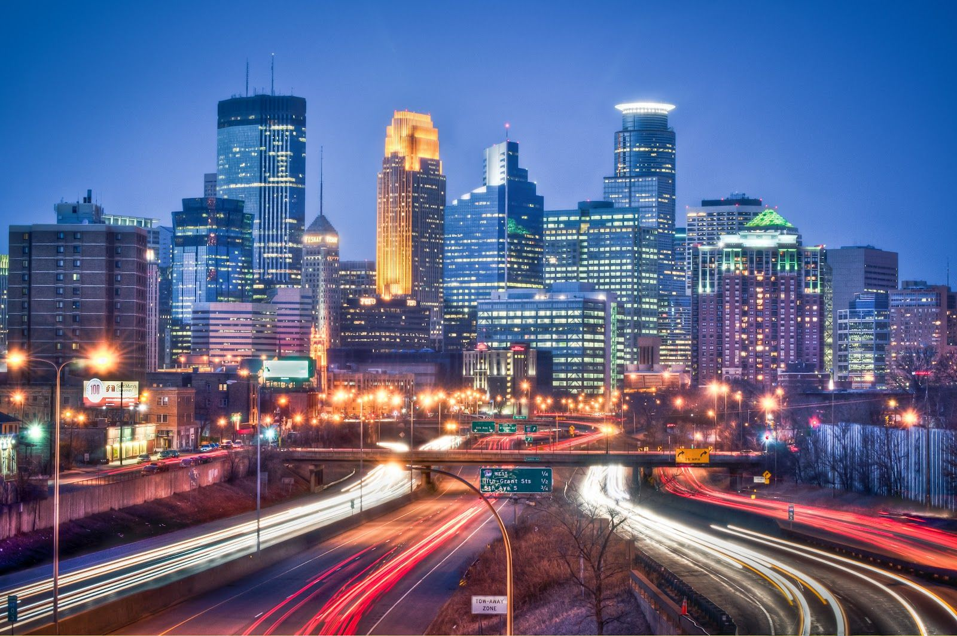
Crime and Weather Comparison
MINNEAPOLIS

Slide 2
Hypothesis: Temperature and weather will affect rates of crime.
Temperature vs Violent Crime
As the temperature increases, will rates of violent crime will also increase?
Adverse weather vs Non-Violent Crime
After major weather events (i.e., tornados, blizzards, floods) will nonviolent crime increase?
Weather and demographics
Will temperature affect crime rates by gender and age differently?
Weather and officer staffing
Is there a correlation between temperature and Officer staffing levels?

Slide 3
Data Sources
worldweatheronline.com
CSV of historical weather data
opendata.minneapolismn.gov
CSV of historical crime data in Minneapolis
api.data.gov
FBI crime statistics API

Slide 4
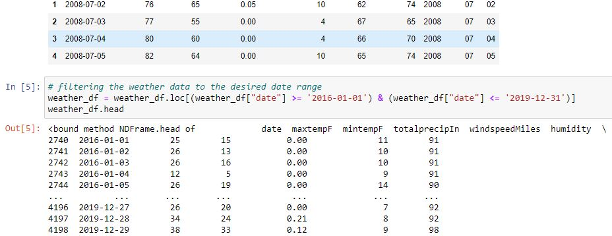
Data Clean-up and Analysis for Temperature vs Violent Crime
Jupyter Notebook

Slide 5
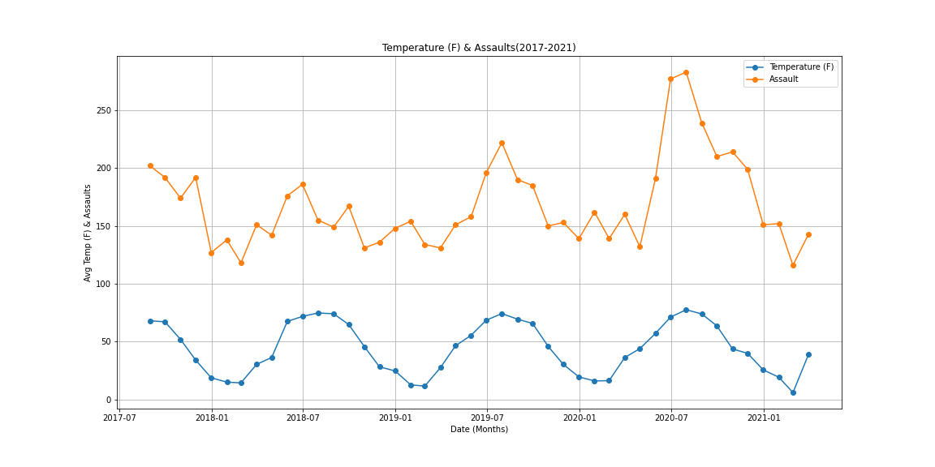
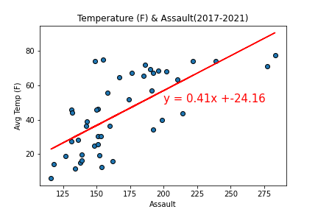
Temperature vs Assault The r-value is: 0.48314455698691894 Over the course of 4 years the Total assaults is 7415.0

Slide 6
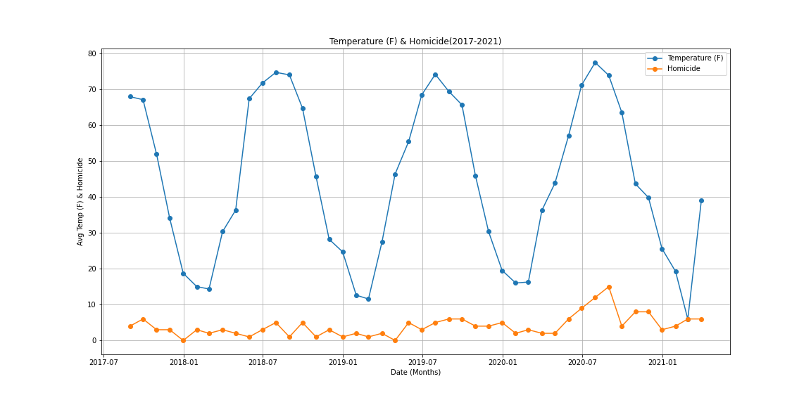
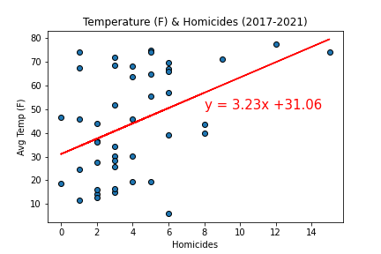
Temperature vs Homicide The r-value is: 0.18790837713090577 Over the course of 4 years the Total homicides is 179.0.

Slide 7
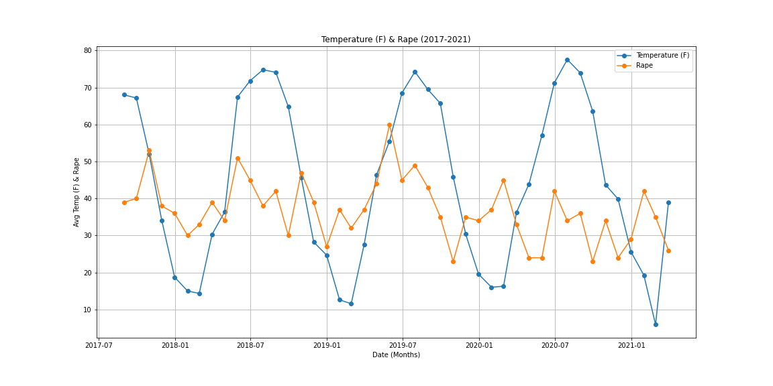
Temperature vs Rape The r-value is: 0.06974819074317856 Over the course of 4 years the Total rapes is 1623.0

Slide 8
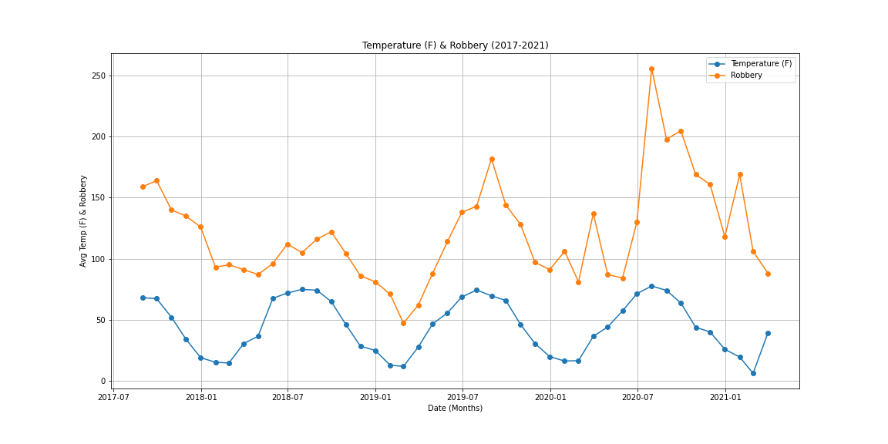
Temperature vs Robbery The r-value is: 0.30462164827108484 Over the course of 4 years the Total robberies is 5312.0

Slide 9
Data Clean-up and Analysis Non-violent crime vs Weather
Jupyter Notebook

Slide 10
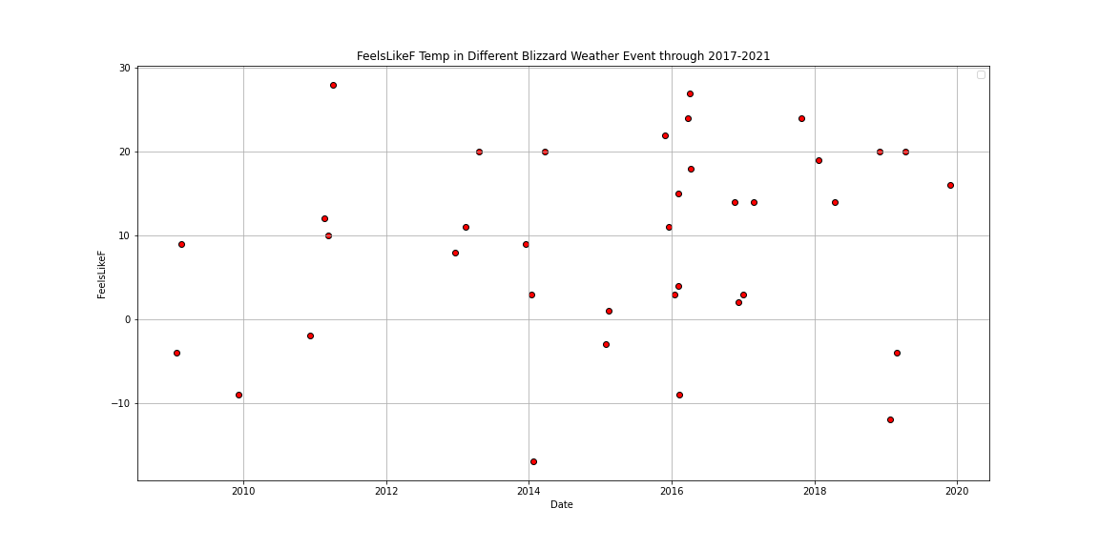
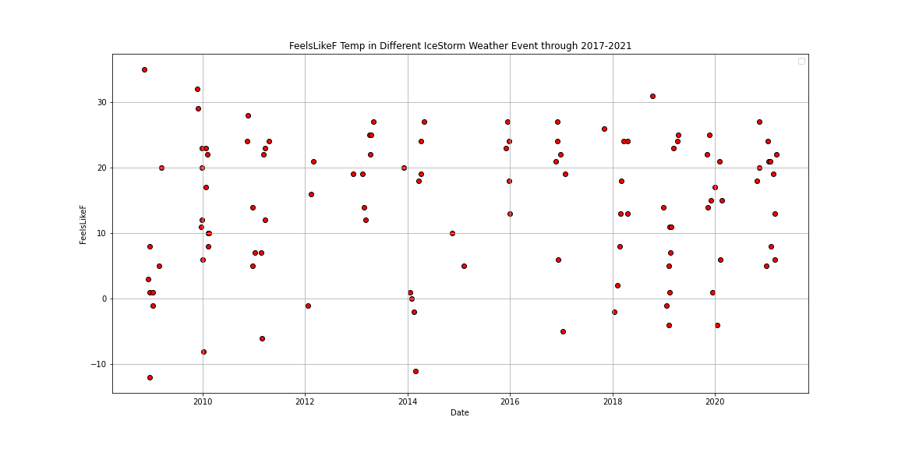
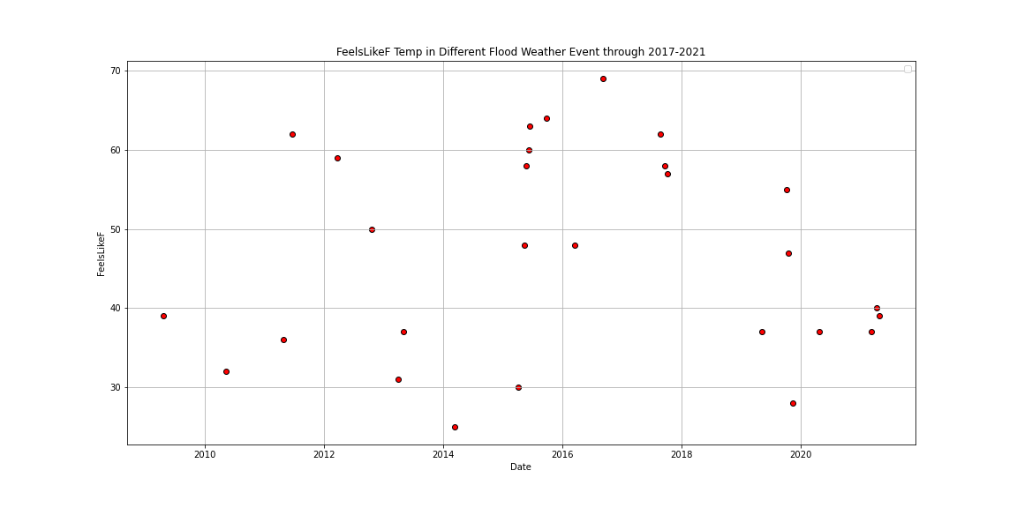
Weather events vs Non-violent crimes
How it feels like(Temperature in F) during different weather events
Notes:
The term blizzard describes a severe winter weather condition (violent snowstorm) characterized by strong winds, cold temperatures, and reduced visibility due to falling or blowing snow. ... Sometimes strong winds only pick up dry snow that has already fallen earlier, which then is known as a ground blizzard.
A flood is an overflow of water that submerges land that is usually dry.
Heavy Rains. The simplest explanation for flooding is heavy rains. ...
Overflowing Rivers. ...
Broken Dams. ...
Urban Drainage Basins. ...
Storm Surges and Tsunamis. ...
Channels with Steep Sides. ...
A Lack of Vegetation. ...
Melting Snow and Ice.
An ice storm is a type of winter storm characterized by freezing rain, also known as a glaze event or, in some parts of the United States, as a silver thaw. The U.S. National Weather Service defines an ice storm as a storm which results in the accumulation of at least 0.25-inch (6.4 mm) of ice on exposed surfaces.
Weather description data from our resource.

Slide 11
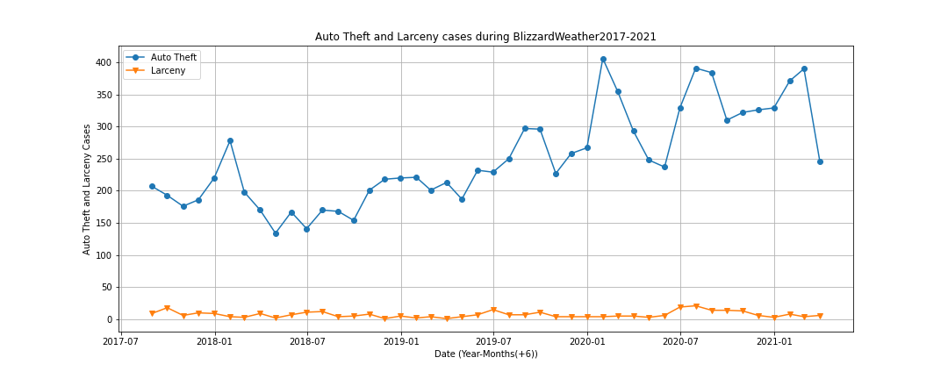
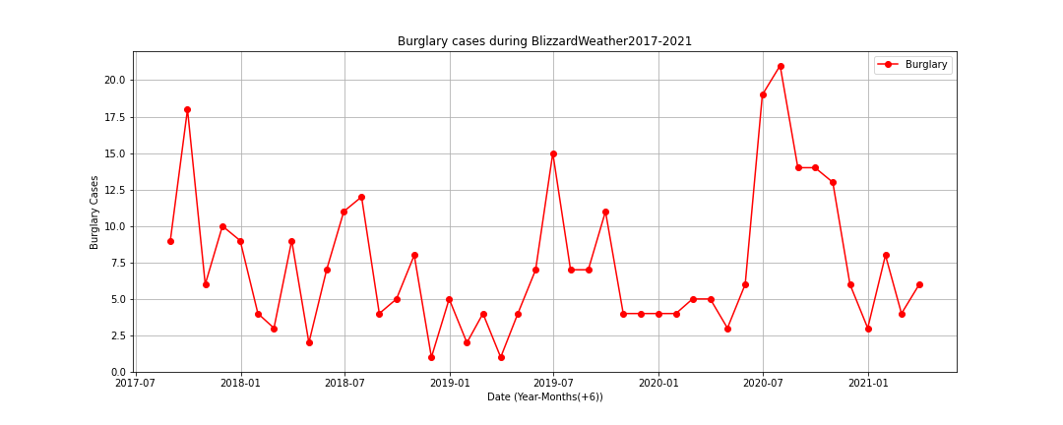
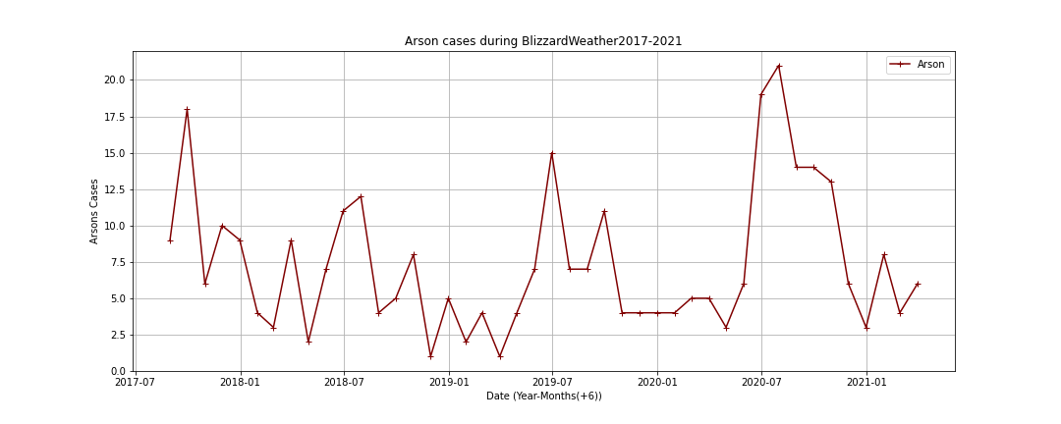
Blizzard weather
Non-violent crime cases during different weather events
Notes:
Nonvio- lent crimes are defined as property, drug, and public order offenses which do not involve a threat of harm or an actual attack upon a victim. Typically, the most frequently identified nonviolent crimes involve drug trafficking, drug possession, burglary, and larceny.
Larceny
Similar to theft, larceny is the taking of property with the intent of depriving the owner of its use.
Burglary
Burglary involves breaking into and entering a structure in order to commit a crime, such as theft.

Slide 12



Flood weather

Slide 13



Ice storm weather

Slide 14
Data Clean-up and Analysis for Temperature vs Violent Crime by Age and Gender
Jupyter Notebook

Slide 15
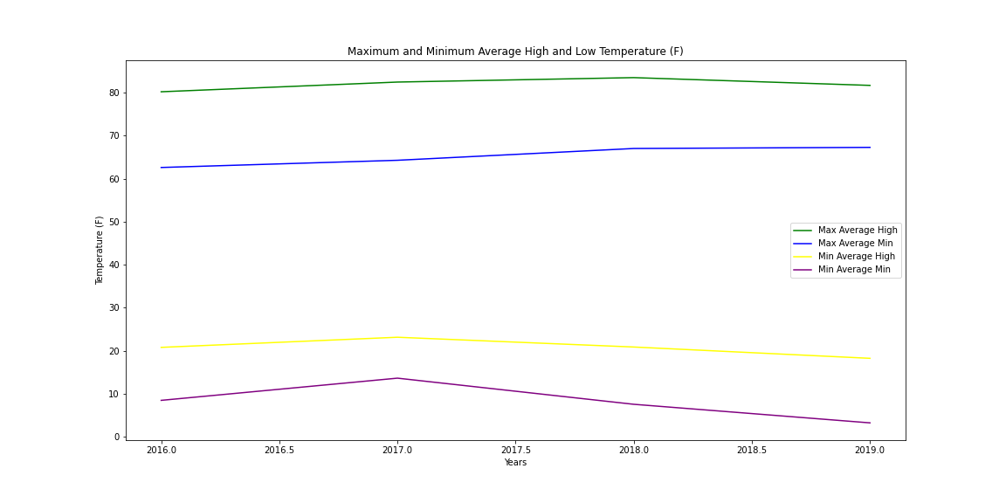
Yearly Weather
Notes:
Combining data to find meaningful results for a year of temperatures
Max average high and max average minimum temperature
Min average high and min average min
2017 mild winter – higher min temps
2018 and 2019 wider variance in temperature overall with lower max average min and higher max average min, but cooler average high temps

Slide 16
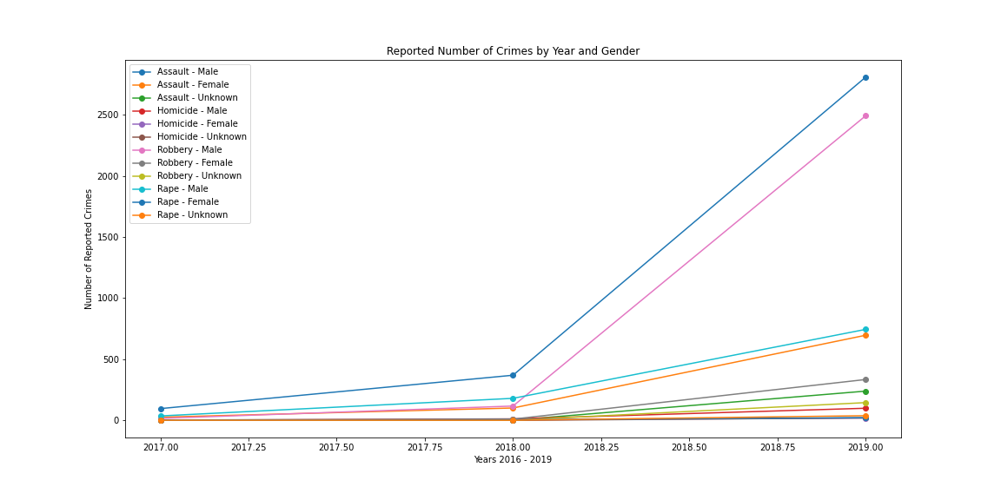
Temperature and Violent Crime by Gender
Yearly Temp Averages
Notes:
All crimes increased
Largest increase in Assault and Robbery by males (2807 (760%) and 2491 (2129%))
Smallest increase in female homicide and unknown homicide (19 (from 4) and 20 (from 0)

Slide 17
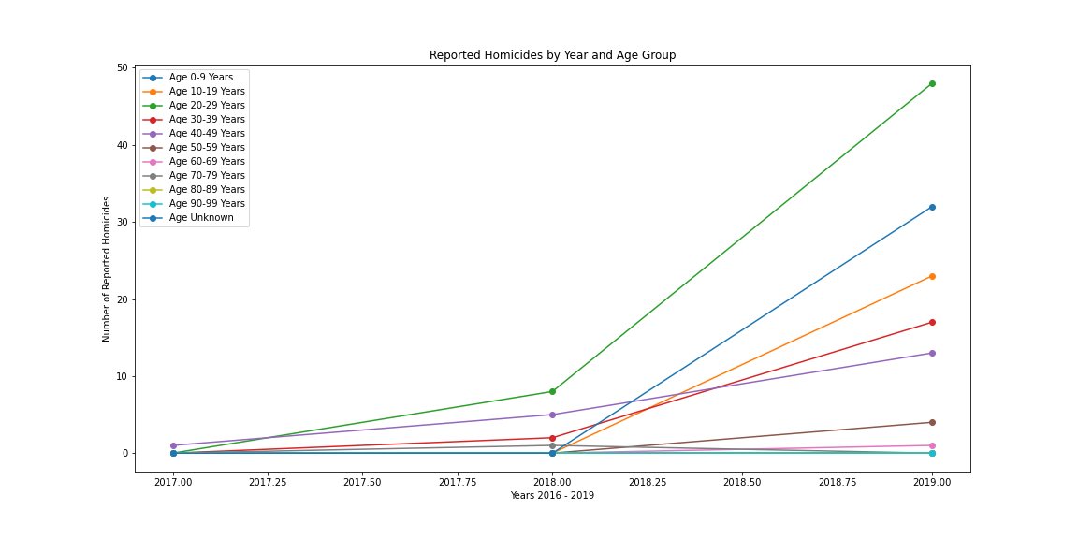
Temperature and Homicide Rate by Age
Yearly Temp Averages
Homicide
Notes:
0-9 only decrease (0-4-2), all others increased
Largest increase in 20-29

Slide 18
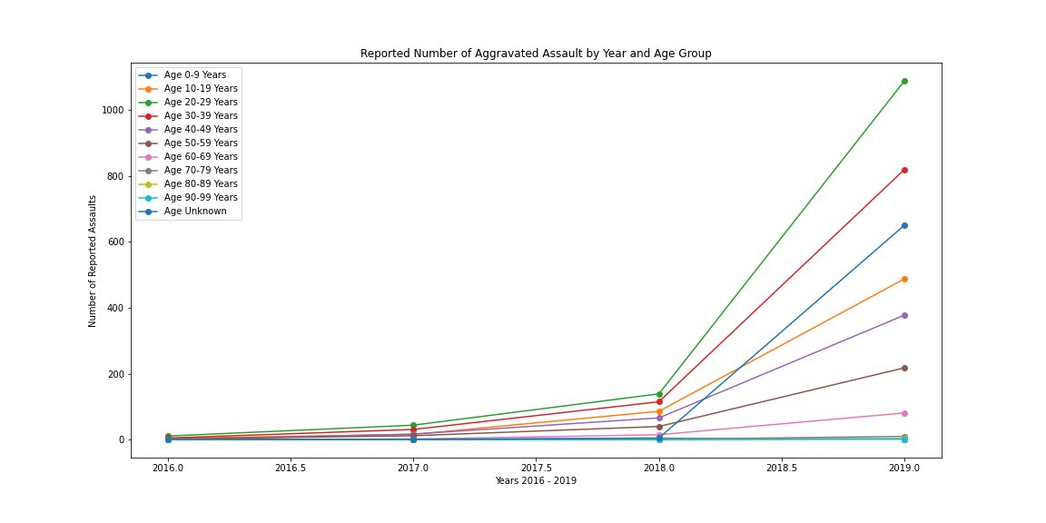
Temperature and Assault Rate by Age
Yearly Temp Averages
Aggravated Assault
Notes:
Only decrease in 70-79 (0-1-0)
Largest increase in 20-29

Slide 19
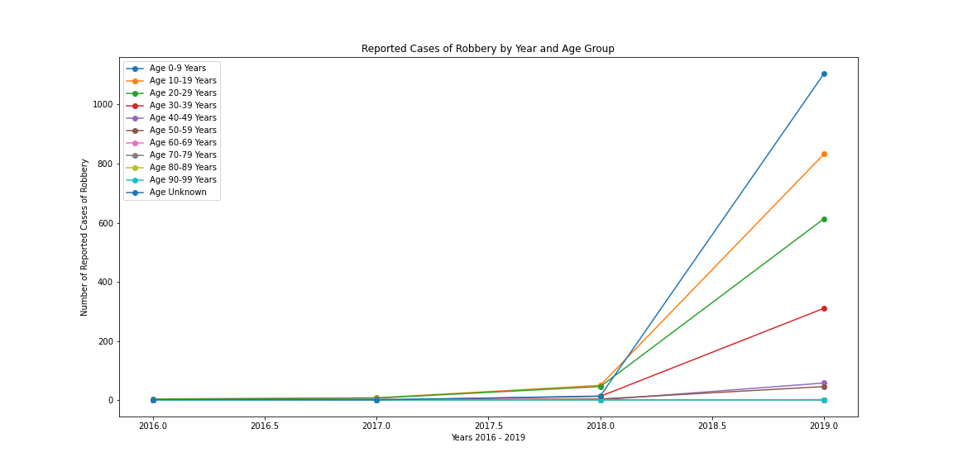
Temperature and Robbery Rate by Age
Yearly Temp Averages
Robbery
Notes:
Only decrease in 40-49
Largest increase in age unknown, followed by 10-19

Slide 20
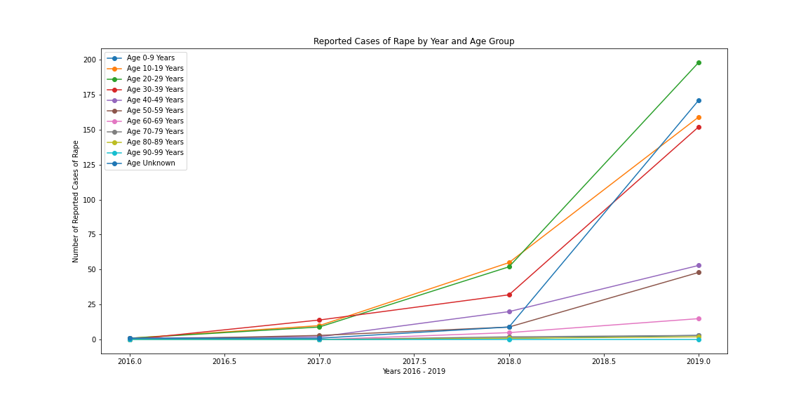
Temperature and Rape Rate by Age
Yearly Temp Averages
Rape
Notes:
No increase in 90-99
Highest occurrence in 20-29
Largest increase in unknown

Slide 21
Conclusion
Given the hypothesis that warmer weather would cause an increase in crime, the yearly data results do not support the statement.
In most of the demographics there were larger increases of crime between 2017 and 2019 while average temperatures were lower than 2016 – 2017. There were no consistent demographics that had decreases.
From the given data, there does not seem to be a strong correlation between temperature and violent crime across gender and age.

Slide 22
Minnesota Police Employment VS. Weather
What has police employment looked like over the past few years ?
Is the hotter weather encouraging more people to become cops ?

Slide 23
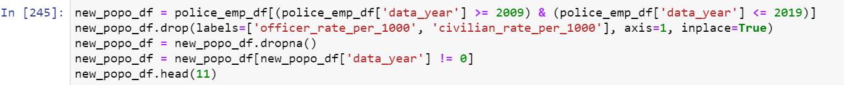
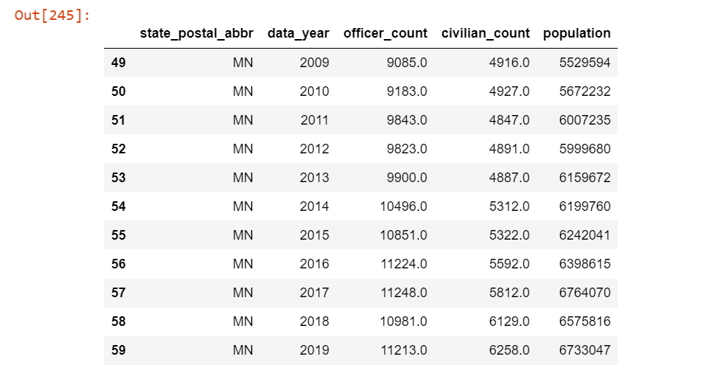
Data Clean-up for Officer count VS. Population

Slide 24
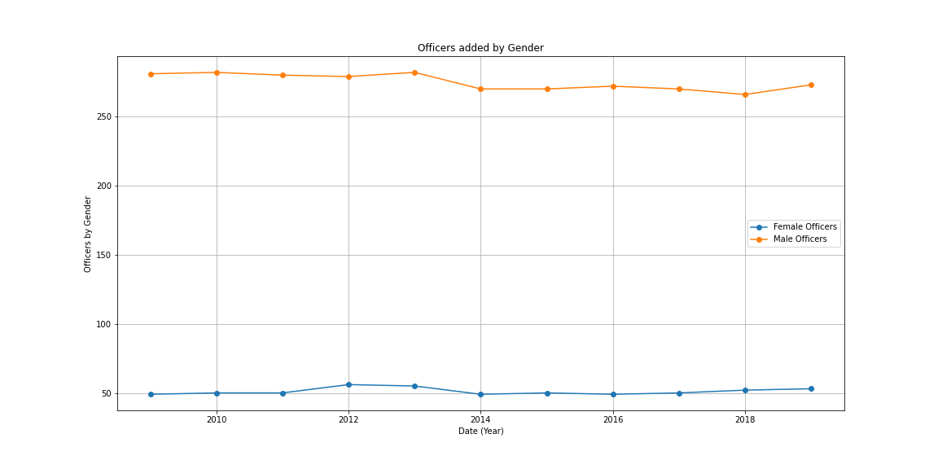
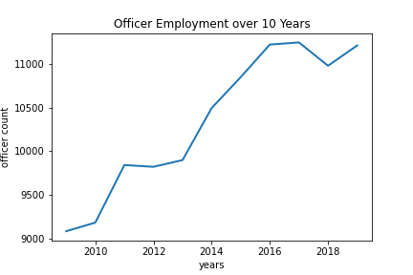
The make up of Minnesota Police
Over the last decade
Make up by gender

Slide 25
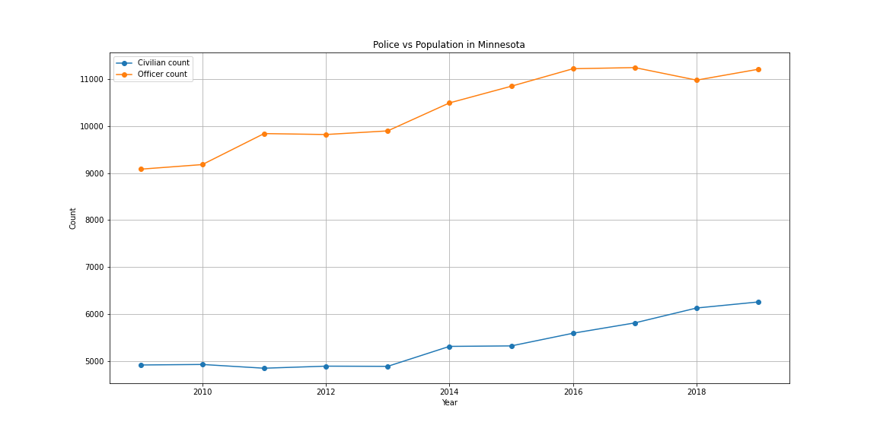
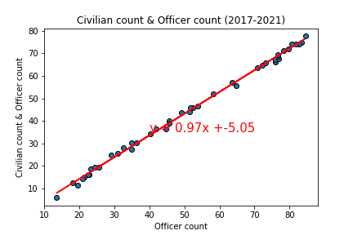
Minnesota Police Compared to Minnesota Population
MN PD growth VS. Population
Correlation between growths

Slide 26
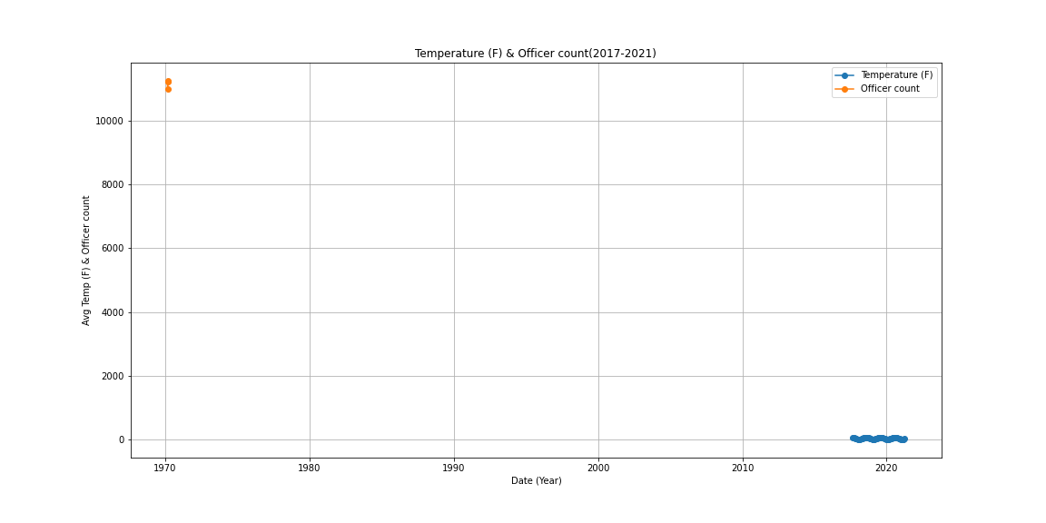
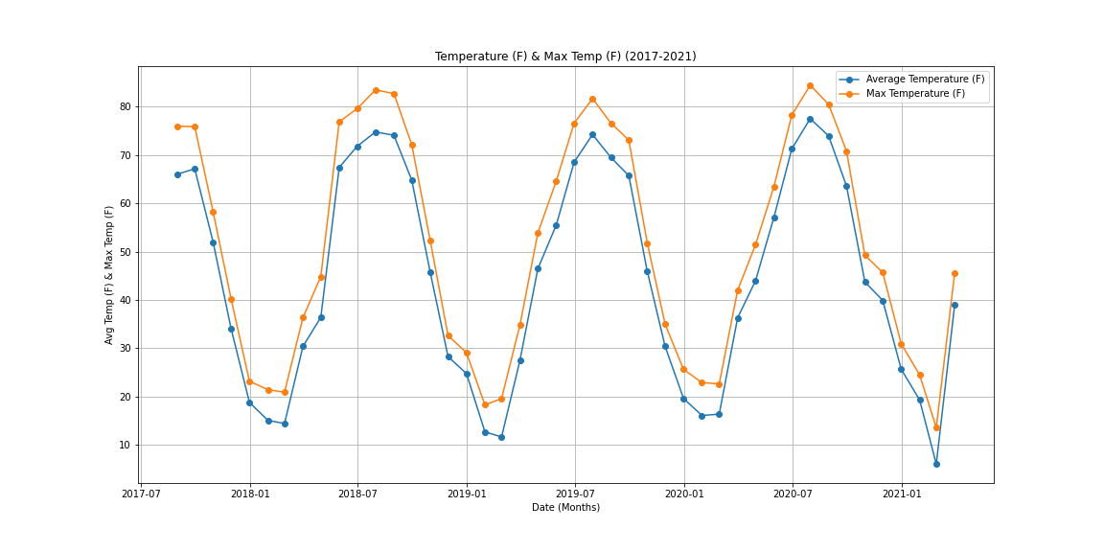
Is there a correlation between Officer employment and the weather ?
Do you see a correlation ?
A more detailed look at the weather.

Slide 27
Conclusion
Based on given data and visuals, the notion that weather influences police employment is unfounded and cannot be supported.

